Slide 1
Project 2
Data Analytics
By Alex, Verushka, Alejandro

Slide 2
Introduction:
Briefly introduce Vanguard and the context of the digital challenge
As the world is evolving and so companies as Vanguard are adapting to new modalities. Vanguard is a US-based investment management company aimed to improve its online customer experience with timely in-context reminders and a revamped User Interface (UI) to make the online process smoother for clients. The experiment conducted through an A/B test was set in two teams. The Control group who evaluated the clients interaction using the conventional online procedure, and the Test group that assess the experienced of the clients using the updated digital interface. Through an iterative manner that includes exploratory data analysis (EDA), key performance indicator (KPI) identification, hypothesis testing, cost-effectiveness assessment, and a comprehensive review of the experiment's design and duration it was assessed if the new UI leads to a better user experience and higher process completion rates.
State the main question: Did the new UI lead to higher completion rates?

Slide 3
Data Overview:
Present an overview of the three datasets used: Client Profiles, Digital Footprints, and Experiment Roster.
Three primary datasets were used in the experiment: the Experiment Roster (df_final_experiment_clients), Digital Footprints (df_final_web_data), and Client Profiles (df_final_demo):
Client Profiles (df_final_demo): Demographics like age, gender, and account details of our clients.
Digital Footprints (df_final_web_data): A detailed trace of client interactions online, divided into two parts: pt.1 and pt.2. It’s recommended to merge these two files prior to a comprehensive data analysis.
Experiment Roster (df_final_experiments_clients): A list revealing which clients were part of the grand experiment.

Slide 4
Data Cleaning and Merging Process
df_final_demo:
Change the name for the following columns: {'bal': 'balance', 'gendr': 'gender'}
Dropped 'X' Gender Values
Changed types to INT for ['clnt_age'], ['clnt_tenure_yr'], ['clnt_tenure_mnth']
Dropped NA - ONLY 14 Values
Change Balance format
df_final_experimental_client:
Changed the name for the following columns: {'Variation':'variation'}
df_final_web_data_pt_1
Dropped NA - Total 2095
df_final_web_data_pt_2
Dropped NA - Total 8669
df_final _demo
Insert without any change
df_final_experimental_clients
Verify if the [client_id] exist in the table already.
df_final_web_data_pt_1 & df_final_web_data_pt_2
Merge the clean data
Separate the data to be inserted two different tables
Table that contains the data from the [client_id] that exist on the df_final_demo_table.
Table that contains the data of the [client_id] that doesn’t on the df_final_demo_table

Slide 5
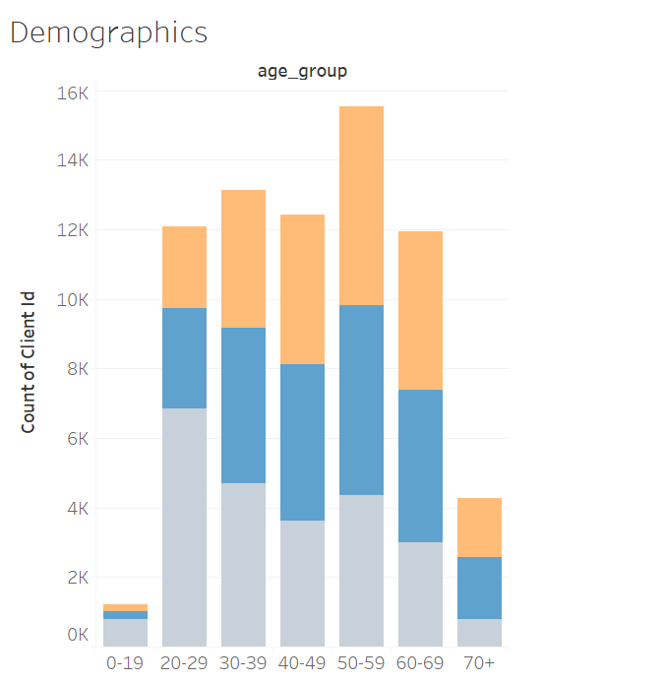

Demographics
Tenure: 12
Gender Rate
M: 33.6
F: 32.2
U: 34.1
Age Average: 47

Slide 6
Performance Metrics:
Define the KPI’s
Time Spent on Each Step:
Definition: The average duration (in time units) that users spend on each step of the online process.
Calculation: Sum of time spent on each step for all users / Total number of users.
Error Rates:
Definition: The frequency of instances where users go back to a previous step, indicating potential confusion or errors.
Calculation: Number of instances where users go back to a previous step / Total number of users.

Slide 7
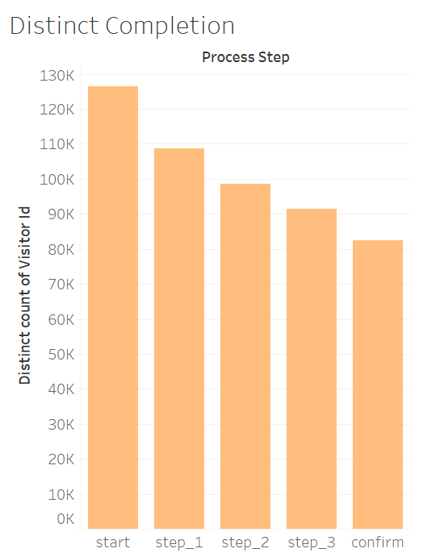
Performance Metrics: Completion Rate
Unique users with ‘Started’ step = 126,365
Unique users with ‘Confirm’ step = 82,503
Calculation: 65% of users reached the final step

Slide 8
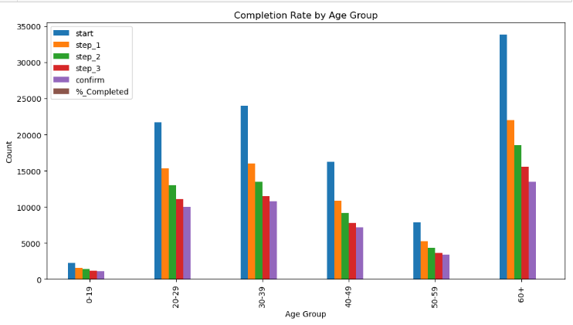
Completion Rate: Age

Slide 9
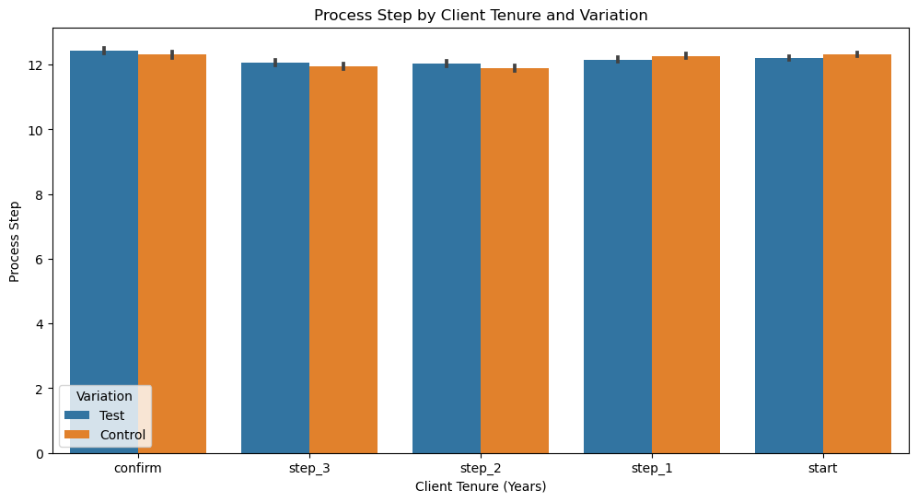
Completion Rate: Tenure

Slide 10
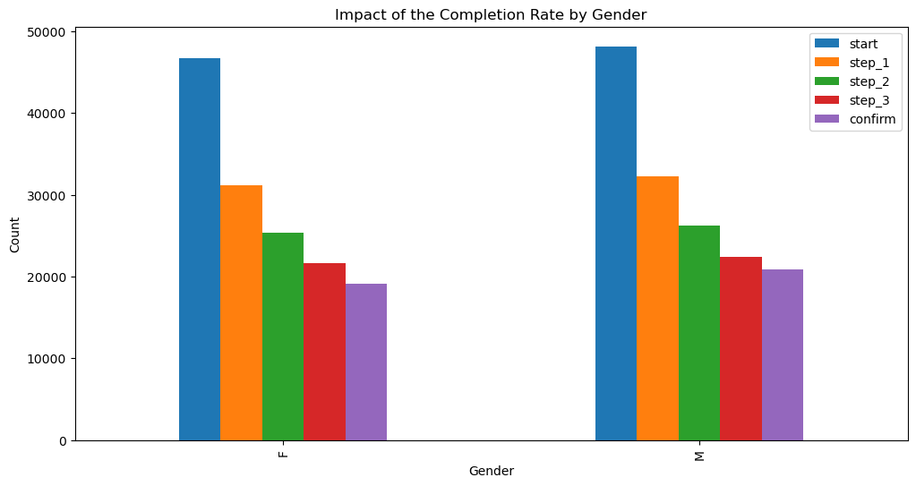
Completion Rate: Gender

Slide 11
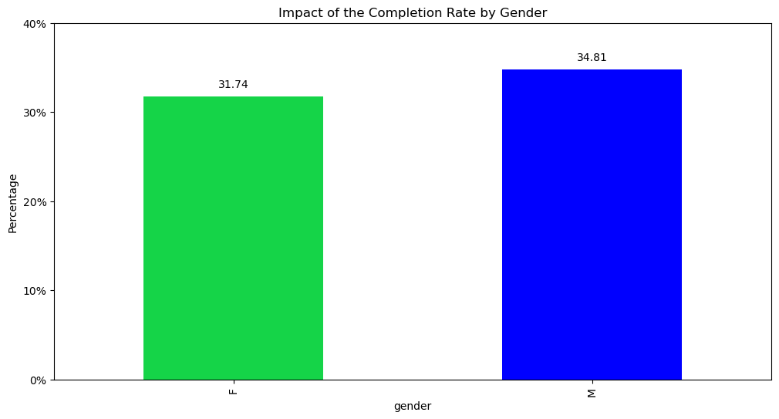
Percentage of Completion Rate: Gender

Slide 12
Hypothesis Testing: Gender
Hypothesis: Gender- Variation Analysis
Null Hypothesis (H0): There are no gender differences that affect engaging with the new or old process.
Alternative Hypothesis (H1): There are gender differences that affect engaging with the new or old process.
Method: Chi-Square Test
Statistic: 1.3767263381592265
P-value = 0.2406595590067408
Results:
Our P-value indicate no strong evidence of a significant association between gender groups and engaging with the new or old process
The null hypothesis (H0) is not rejected.

Slide 13
Hypothesis Testing: Gender
Hypothesis: Gender- Completion Rate Analysis
Null Hypothesis (H0): Gender does not significantly impact the completion rate for the new design.
Alternative Hypothesis (H1): Gender significantly impacts the completion rate for the new design.
Method: Chi-Square Test
Statistic= 164.15404571962685
P-value = 4.492601107945011e-30
Results:
Our p-value is very small, there is a significant difference. Meaning the gender significantly impacts the completion rate for the new design (H1).
We reject the null hypothesis (H0)

Slide 14
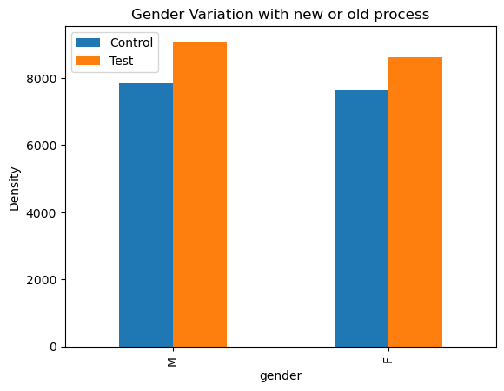
Hypothesis Testing: Gender
Hypothesis: Variation Analysis
Hypothesis: Completion Rate Analysis

Slide 15
Hypothesis Testing: AGE
PART 1:
(H0): The average age of clients engaging with the new process is the same as those engaging with the old process.
(H1): The average age of clients engaging with the new process is different from those engaging with the old process.
Results:
P-value = 0.7310 which was greater than significant level of 0.05
We fail to reject null hypothesis (H0)

Slide 16
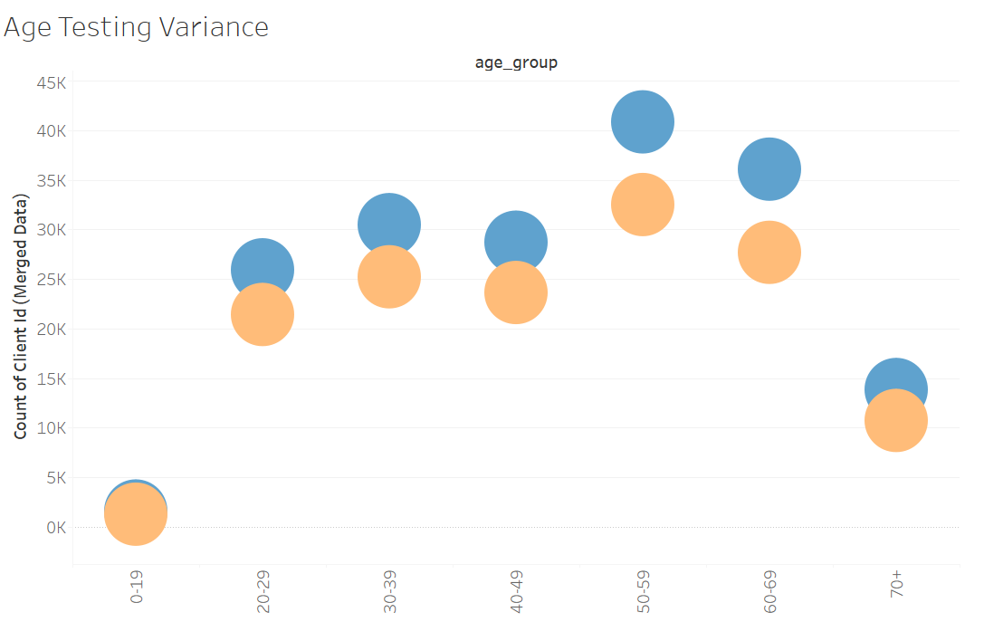
Hypothesis Testing: AGE
Not enough evidence to establish a difference in engagement based on Age!

Slide 17
Hypothesis Testing: AGE
PART 2:
(H0): Age does not significantly impact the completion rate for the design.
(H1): Age significantly impacts the completion rate for the design.
Results:
P-value = 1.0272886511987996e-86
P-value is LOWER the the common significance level of 0.05.
We reject null hypothesis (H0) and accept the alternative hypothesis (H1)

Slide 18
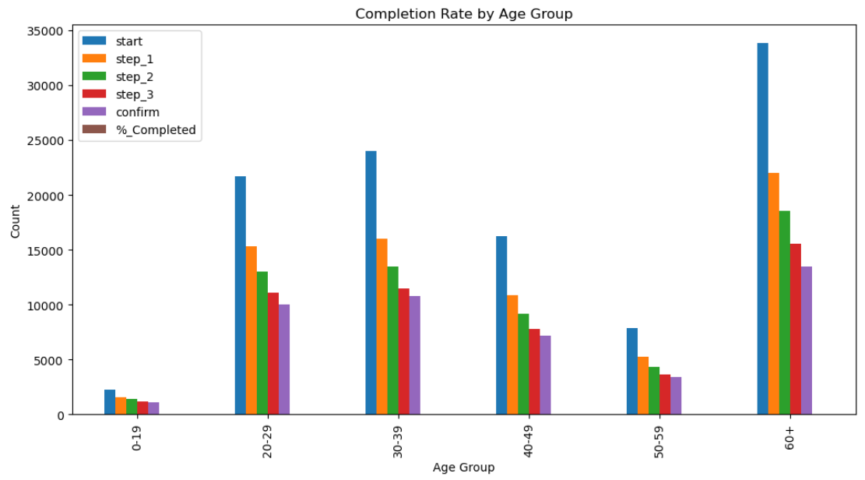
Hypothesis Testing: AGE

Slide 19
Hypothesis Testing: Tenure
Hypothesis 1:
Hypothesis 2:
Title: Client Tenure
Null Hypothesis: Those using the new method have an average customer tenure (length of time with Vanguard) that is equal to that of those using the old process.
Alternative Hypothesis: Those using the new method have a different average client tenure than those using the old process.
Title: Client Tenure-Related Completion Rate
Null Hypothesis: There is no discernible relationship between client tenure and the new design's completion rate.
Alternative Hypothesis: The new design's completion rate is greatly impacted by the length of the client's stay.

Slide 20
Hypothesis Testing: Tenure
Hypothesis 1:
Hypothesis 2:
Result: Client Tenure
Method: T-Test
Statistic: 1.7096153693381262
P-Value: 0.08734316699459853
Final Result:
Reject the null hypothesis without success. The duration of clients does not significantly alter.
Result: Client Tenure-Related Completion Rate
Method: Chi-Squared Test
Statistic: 426.6654338409862
P-Value: 1.4400822927558666e-16
Final Result:
Don't accept the null hypothesis. Completion rate is greatly impacted by client tenure.

Slide 21
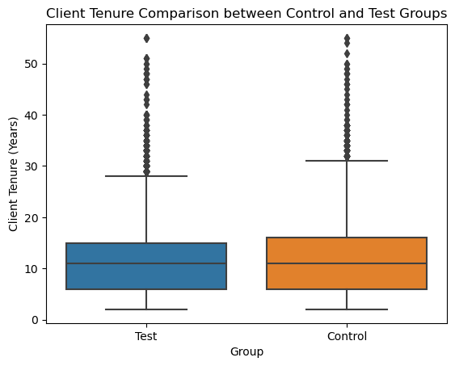
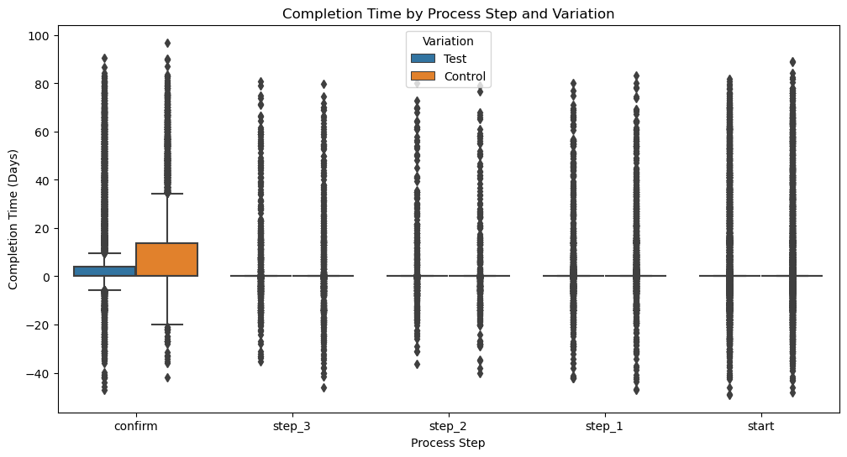
Hypothesis Testing: Tenure
Hypothesis 1:
Hypothesis 2:
Graph: Client Tenure
Result: Client Tenure-Related Completion Rate

Slide 22
Experiment Evaluation:
Evaluation of the Design of the Experiment:
Randomization: Verify if the randomization procedures carried out guarantee that the demographics and other pertinent characteristics of the two groups are similar.
Biases: Examine any potential influences or outcomes, such as selective biases and different variables.
Experiment Structure: Check to see if both groups actions confirm that they were the same.

Slide 23
Experiment Evaluation:
Suggestion for the project:
Demographic Information: Take into consideration whether knowing more about the client’s demographics could yield greater insights.
User Interaction Data: Look into the possibilities of collecting more specific information about the user interactions.
Feedback Surveys: Customer feedback on the new layout, usability and satisfaction might provide insights.

Slide 24
Tableau Visualization: Age
Tableau Visualization: Tenure
Links to the Tableau Dashboards of each Hypothesis:
Hypothesis 1 and Hypothesis 2 Dashboard
Links to the Tableau Dashboards of each Hypothesis:
Hypothesis 1 Dashboard
Tableau Visualization: Gender
Links to the Tableau Dashboards of Hypothesis 1 and Hypothesis 2:
Hypothesis 1 and Hypothesis 2 Dashboard
Hypothesis 2 Dashboard

Slide 25
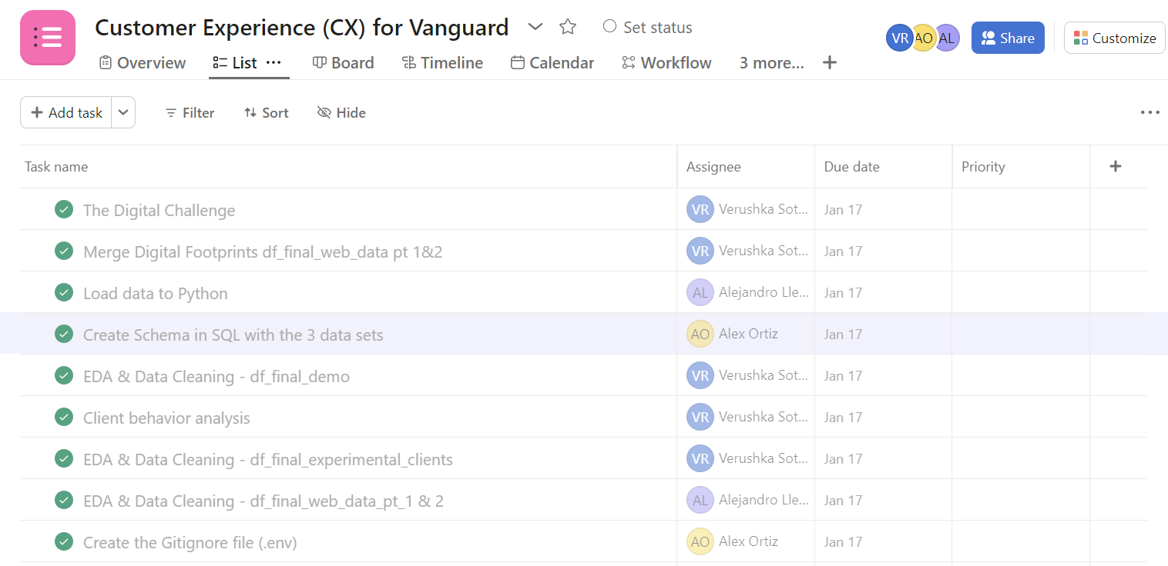
Teamwork & Project Management:
We used ASANA as our Kanban board.

Slide 26
Challenges & Learnings:
1. Ensuring Random Assignment in A/B Test:
Challenge: Using A/B testing principles to differentiate between control and test groups. By looking at the distribution of clients in both groups.
Learnings: Getting accurate results from A/B testing requires careful setups and execution to validate the data.
2. Variability in User Behavior:
Challenge: Take into account behavioral variations in order to conduct a more thorough analysis.
Learnings: It was important to take into account and acknowledge the variances in user behavior when interpreting the results.

Slide 27
Challenges & Learnings:
3. Defining and Capturing User Journey:
Challenge: Take into consideration the tracking methods put in place such as the ‘date_time’ and ‘process_step’ columns.
Learnings: Comprehension of the user path, evidenced by the data, for placing experiments outcomes.
4. Grouping:
Challenge: Grouping variables like age ranges was challenging when dealing with data types.
Learning: Data conversions in categorical data need to take into account type of analysis.

Slide 28
Conclusion:
Key Findings:
Client Demographic: Investigate the age, duration of services and familiarity of the client.
KPIs & Metrics: Identify key performance indicators, such as mistakes rates, time spent on each step and completion rates.
Testing Hypothesis: Compare the completion rates of the Test and Control groups, examining the rise of completion rates.
Evaluation: Taking into account duration, biases and randomization, investigate if the clients were split evenly between the two groups.
Visualization: Use Tableau to create dynamic and perceptive visualizations.

Slide 29
Conclusion:
Final Verdict:
The outcomes of the examination of KPIs and hypothesis testing became the basis for a determination of the efficacy of the new digital interface.
Suggestions to Vanguard:
Effectiveness: Assess whether the trial was properly organized and whether the clients where split equally and at random.
Evaluation: Determine if the experiment’s duration was sufficient to collect useful data on the new interface.
Additional Data: Determine what more information could improve the analysis.

